Slide 1


Bodhi Day
Human Relations, Diversity & Equity
Student Support and Attendance Services

Slide 2
Would you rather...
Be the inventor of a drug that cures a deadly disease?
Be the first person to explore a planet?

Slide 3
Objectives
Learn what Bodhi Day is
Understand the history of the holiday
Identify how and why it is celebrated

Slide 4
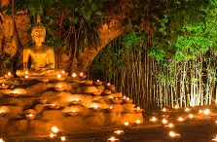
What is Bodhi Day?
It is marked as the day the Historic Buddha, Siddhartha Gautama, achieved "enlightenment."
It is celebrated on the 8th day of the 12th month of the lunar year, which changes from year to year. Lasts 30 days.
Many celebrate on Dec. 8th every year.

Slide 5
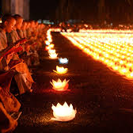
The Story
Siddhartha Gautama was a coddled prince, shielded from the "unpleasant reality of the world". One day, he went out into the kingdom and saw people suffering and witnessed death. He was shocked that not everyone experienced the joys of life.
He ran away from his life to find "true meaning." He studied under several different masters until he was near death, materially and emotionally bankrupt.

Slide 6
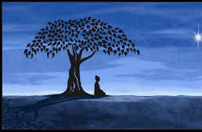
The Story
It is then that he went to rest under a Bodhi tree and vowed to stay there until he found what he was looking for. He sat in meditation for days (ranging from 7 days to 49 years, depending on the different beliefs).
On the 8th day of the 12th month of the lunar year, he awoke enlightened and he could "See". This realization became the 4 Noble Truths (Nirvana).
He was now the Buddha, the Teacher.

Slide 7
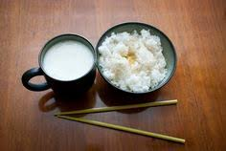
How is it celebrated?
Services and traditions vary among Buddhist sects. However, all such services commemorate the Buddha's achievement of Nirvana and what it means for Buddhism today.
Services and traditions include, additional meditation, study of the Dharma (Buddhist teachings), chanting of Buddhist texts (sutras), or performing kind acts towards others.
Some Buddhists celebrate with a traditional meal of tea, cakes, and readings. Many eat rice and milk the morning of Bodhi day to commemorate the first meal the Buddha ate after he was enlightened.

Slide 8
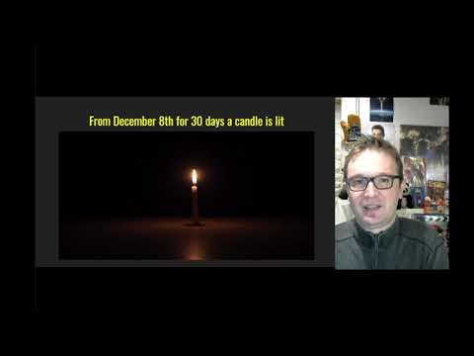
Buddhism: Bodhi Day
Notes:
youtube.com/watch?v=zst7WLCSX_s&feature=youtu.be
6:36

Slide 9
Time to Share
This holiday celebrates the enlightenment of the Buddha. Do you think the people can achieve enlightenment? Why or why not?
If you could be enlightened about something, what would it be?

Slide 10


Which is a better cell phone?

Slide 11

Teacher Feedback Survey
Notes:
Teacher: please take a few moments to complete the quick feedback survey by scanning the QR code

Slide 12
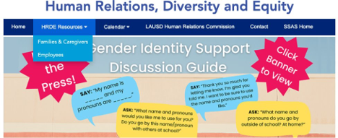
For additional resources, visit us at: https://www.lausd.org/human-relations

